Slide 1
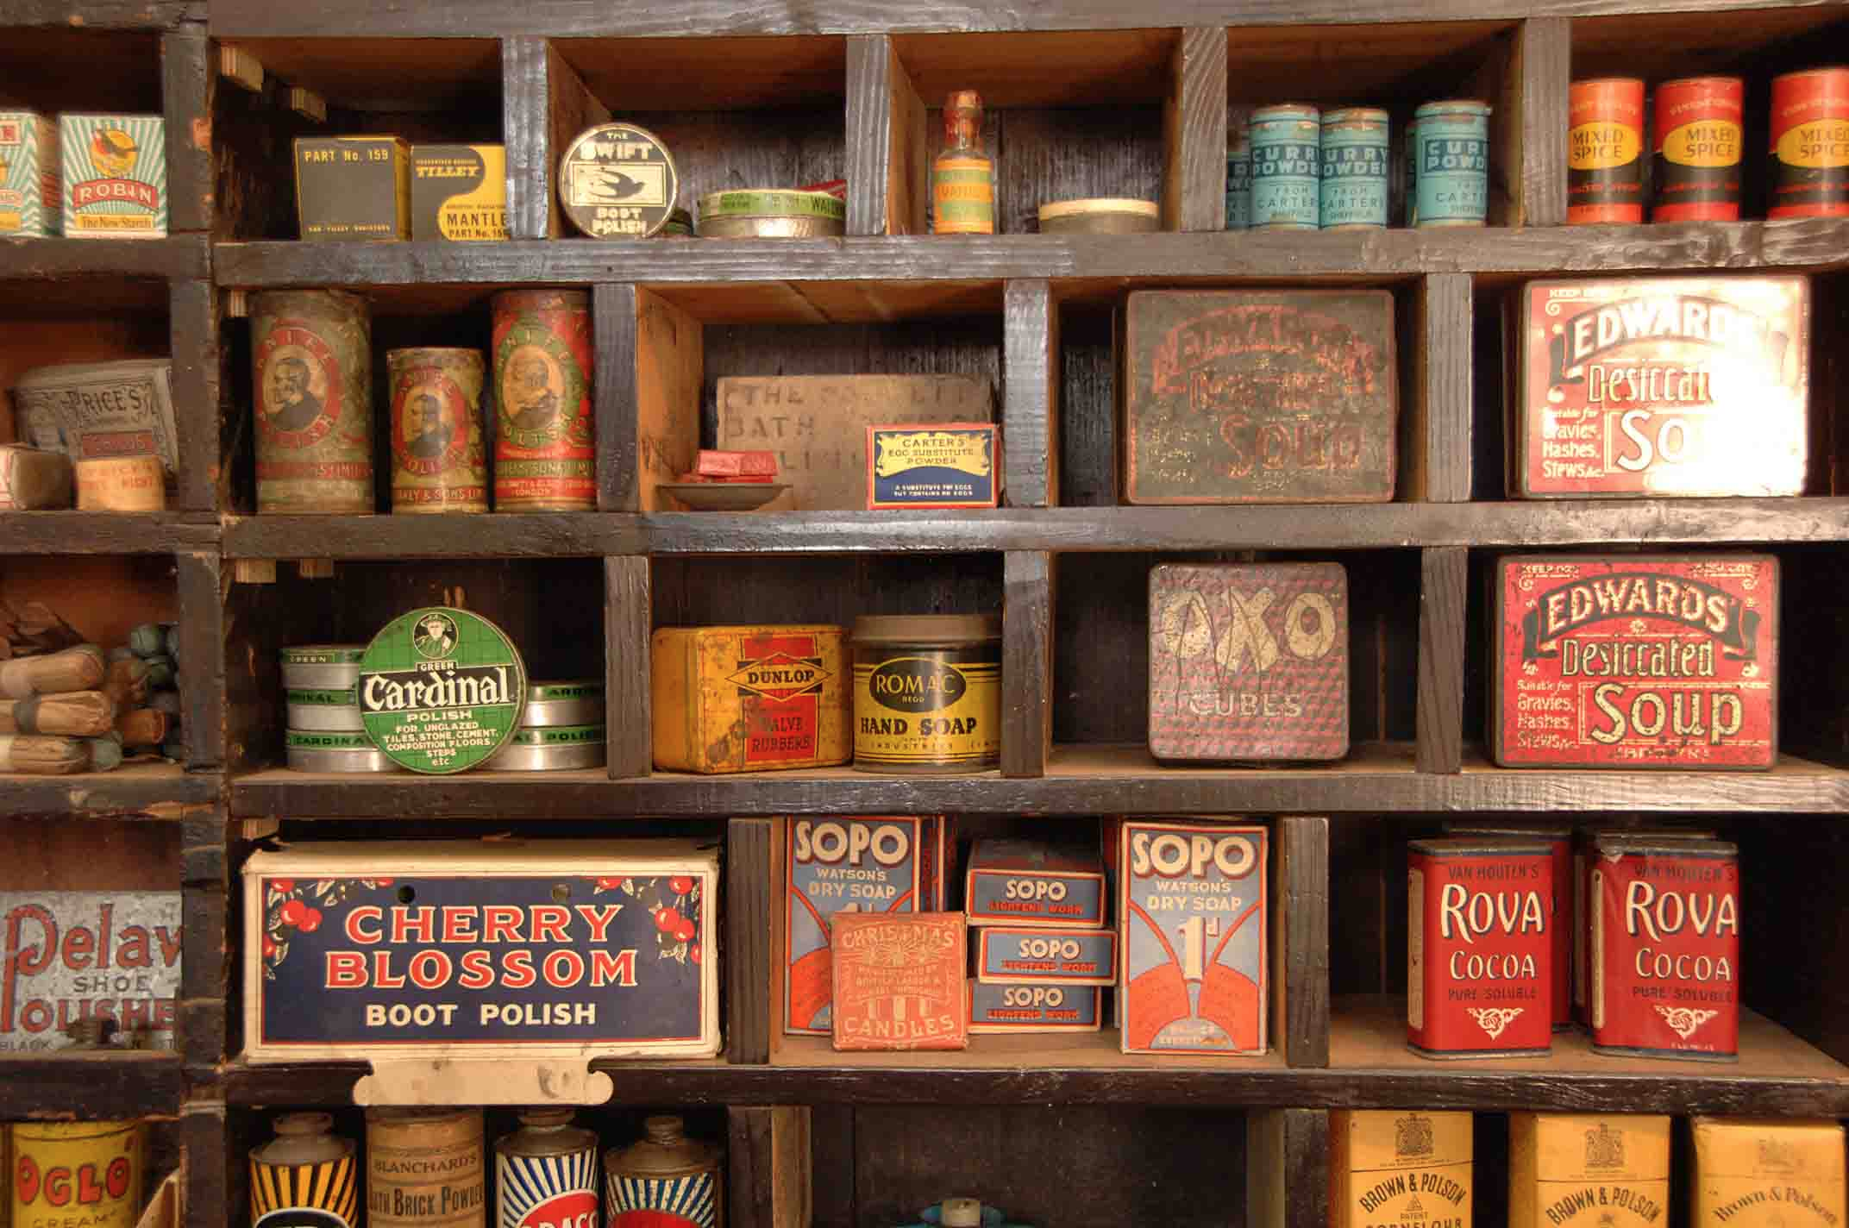
Sets and Maps
Collection Classes Part 3
Chris Piech
CS 106B
Lecture 4
Jan 13, 2015

Slide 2
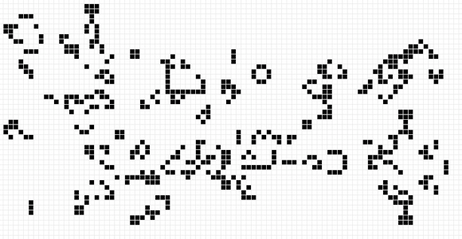
Life is Due Friday

Slide 3


Slide 4
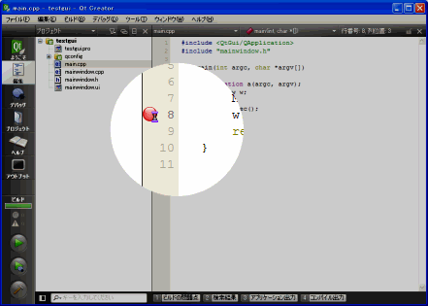
Break Points

Slide 5
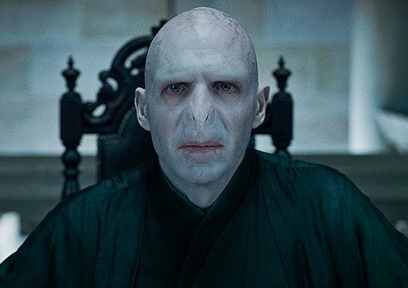
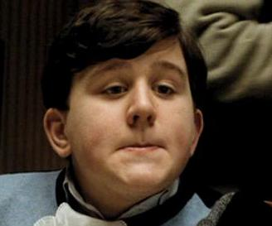

Interesting Puzzle
Counterfeiter
User
You (Distributor)

Slide 6
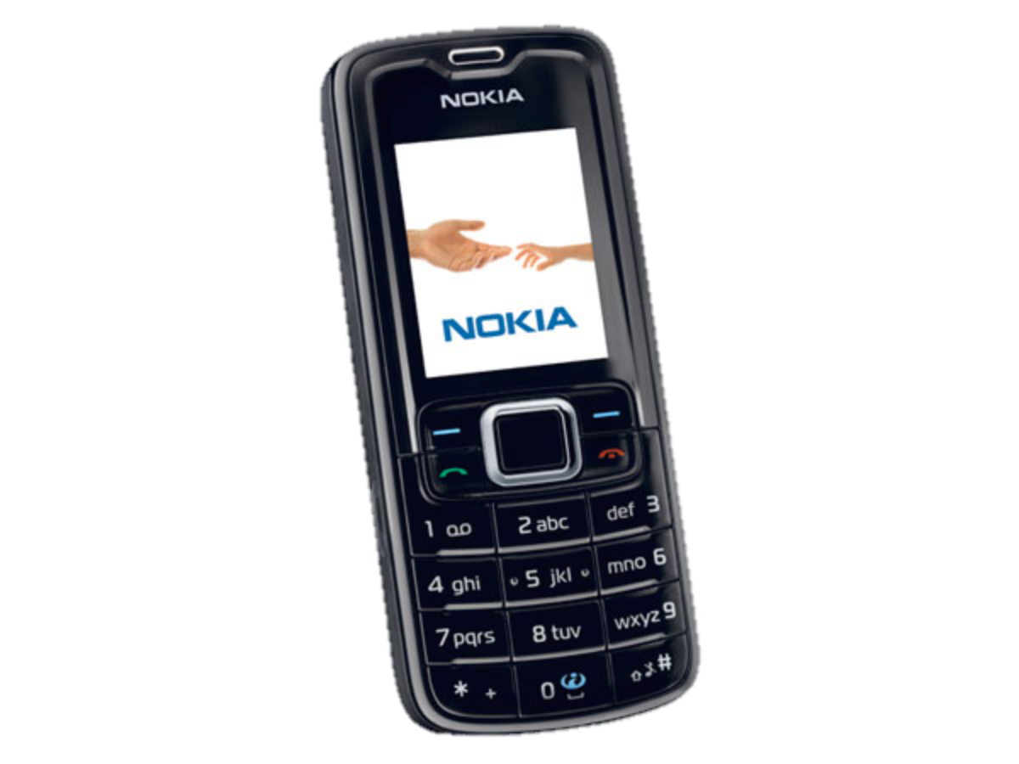
Interesting Puzzle
Counterfeiter
?
User
You (Distributor)

Slide 7
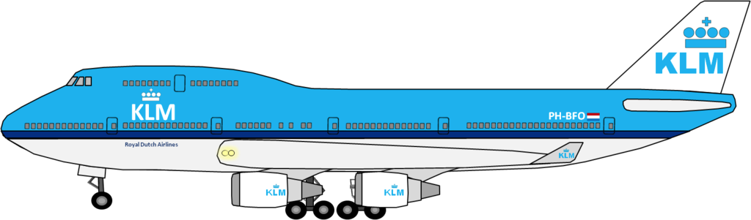
Fake Medicine is a Problem
700,000 deaths a year from fake malaria and tuberculosis drugs [1]
Equivalent of this many crashes per day
[1] http://www.un.org/africarenewal/magazine/may-2013/counterfeit-drugs-raise-africa%E2%80%99s-temperature

Slide 8
Interesting Puzzle
Counterfeiter
?
User
You (Distributor)

Slide 9
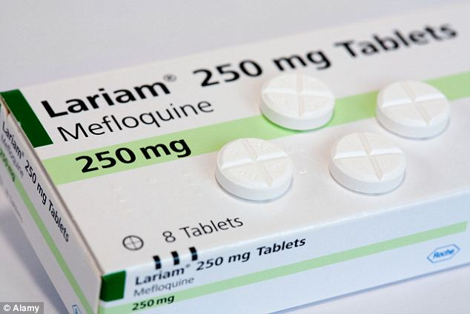
Real Life Challenge
Counterfeiter
?
User
You (Distributor)

Slide 10
Solution?

Slide 11
Friday

Slide 12
Collections
Vector
Grid
Map
Stack
Queue
Set

Slide 13
Collections
Vector
Grid
Map
Stack
Queue
Set

Slide 14


Today’s Goals
Learn how to use Sets
Learn how to use Maps
See a previously never seen before computer program

Slide 15
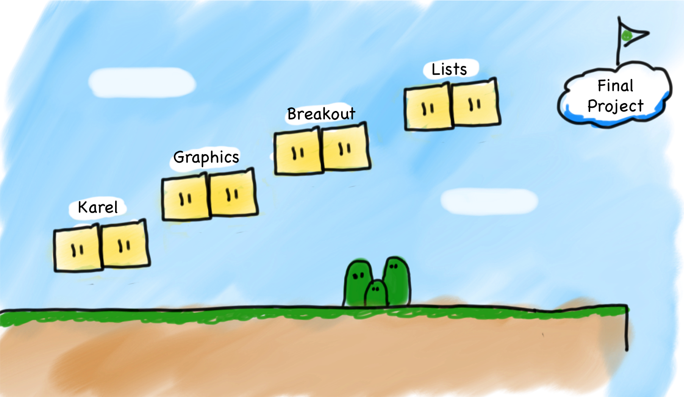
Malaria?
Wednesday
Bananagrams
Maps
Sets

Slide 16

Malaria?
Wednesday
Bananagrams
Maps
Sets

Slide 17
Sets and Maps
Set: Collection of elements with no duplicates;
fast for searching.
Map: Key/value pairs;
Use a key to find its associated value.
"the"
"of"
”Chris"
"867-5309"
"if"
"to"
"down"
"from"
"Jenny"
"685-9138"
"by"
"she"
"you"
"in"
"why"
"him"
"Mehran"
”866-6586"
set
map

Slide 18


Problem #1: Count Unique Words

Slide 19
Sets
"the"
"of"
"if"
set.contains("to")
"to"
"down"
"from"
true
"by"
"she"
set.contains("be")
"you"
false
"in"
"why"
"him"
set

Slide 20
Sets
Set: A collection of unique values (no duplicates allowed)
add, remove, search (contains)
We don't think of a set as having any indexes
Fast
"the"
"of"
"if"
set.contains("to")
"to"
"down"
"from"
true
"by"
"she"
set.contains("be")
"you"
false
"in"
"why"
"him"
set

Slide 21
The Set Essentials
set.size()
Returns the number of elements in the set.
set.add(value)
Adds a new value to the set (ignores it if the value already was in the set).
Set.contains(value)
Return true if the value is in the set.

Slide 22
Looping Over a Set
for (type name : collection) {
statements;
}

Slide 23
Looping Over a Set
for (type name : collection) {
statements;
}
The "for-each" loop provides a clean syntax for looping over the elements of a Set, Vector, or most other collections.
Sets have no indexes; can't use a normal for loop and get each element [i]
for (int i = 0; i < set.size(); i++) {
do something with set[i]; // does not compile
}

Slide 24


Types of Sets
Set
HashSet
Iterate over elements in sorted order
Element order is jumbled
Really Fast
Really, Ridiculously Fast
Implemented using a binary search tree
Implemented using a hash table

Slide 25
Simple Example
Set<string> friends;
friends.add(“waddie”);
friends.add(“megan”);
cout << friends.contains(“voldemort”) << endl;
for(string person : friends) {
cout << person << endl;
}

Slide 26


Slide 27
Set Operands
s1 == s2 | true if the sets contain exactly the same elements
s1 != s2 | true if the sets don't contain the same elements
s1 + s2 | returns the union of s1 and s2 (elements from either)
s1 * s2 | returns intersection of s1 and s2 (elements in both)
s1 - s2 | returns difference of s1, s2 (elements in s1 but not s2)

Slide 28
Set Operands
int main() {
Set<string> allStudents = loadStanford();
Set<string> left;
for(string student : allStudents){
if(audienceLeft(student)) {
left.add(student);
}
}
Set<string> hats;
for(string student : allStudents){
if(isWearingHat(student)) {
hats.add(student);
}
}
// more code coming...
}

Slide 29
Set Operands
int main() {
Set<string> allStudents = loadStanford();
Set<string> left;
for(string student : allStudents){
if(audienceLeft(student)) {
left.add(student);
}
}
Set<string> hats;
for(string student : allStudents){
if(isWearingHat(student)) {
hats.add(student);
}
}
// more code coming...
}
Students on the audience left of the stage

Slide 30
Set Operands
int main() {
Set<string> allStudents = loadStanford();
Set<string> left;
for(string student : allStudents){
if(audienceLeft(student)) {
left.add(student);
}
}
Set<string> hats;
for(string student : allStudents){
if(isWearingHat(student)) {
hats.add(student);
}
}
// more code coming...
}
Students wearing hats

Slide 31
Set Operands
allStudents, hats, left

Slide 32
Set Operands
allStudents, hats, left
stand(allStudents);

Slide 34
Set Operands
allStudents, hats, left
stand(left);

Slide 36
Set Operands
allStudents, hats, left
Set<string> combine;
combine = left + hats;
Elements in either set

Slide 37
Set Operands
allStudents, hats, left
Set<string> combine;
combine = left + hats;
stand(combine);

Slide 39
Set Operands
allStudents, hats, left
Set<string> combine;
combine = left * hats;
Elements in both sets

Slide 40
Set Operands
allStudents, hats, left
Set<string> combine;
combine = left * hats;
stand(combine);

Slide 41
Set Operands

Slide 42
Malaria?
Wednesday
Bananagrams
Maps
Sets

Slide 43
Malaria?
Wednesday
Bananagrams
Maps
Sets

Slide 44
Maps
map: A collection of pairs (k, v), sometimes called key/value pairs, where v can be found quickly if you know k.
a.k.a. dictionary, associative array, hash
a generalization of an array, where the "indexes" need not be ints.
"Chris"
"867-5309"
"Jenny"
"685-9138"
"Mehran"
"866-6586"

Slide 45
Using Maps
A map allows you to get from one half of a pair to the other.
Store an association from "Suzy" to "206-685-2181".
// key value
// m["Suzy"] = "206-685-2181";
m.put("Suzy", "206-685-2181");
Map

Slide 46
Using Maps
A map allows you to get from one half of a pair to the other.
Store an association from "Suzy" to "206-685-2181".
// key value
// m["Suzy"] = "206-685-2181";
m.put("Suzy", "206-685-2181");
Map
What was Suzy’s phone number?
// m["Suzy"]
m.get("Suzy")
Map
"206-685-2181"

Slide 47
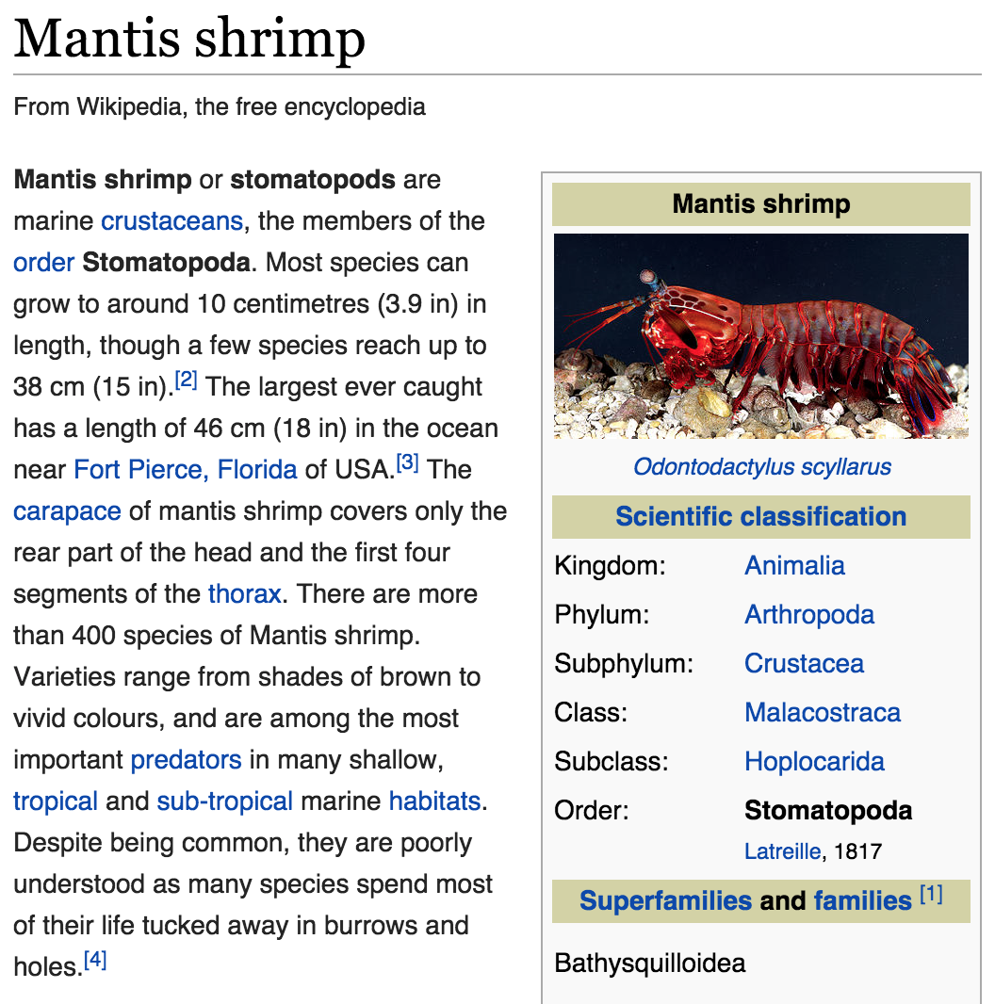
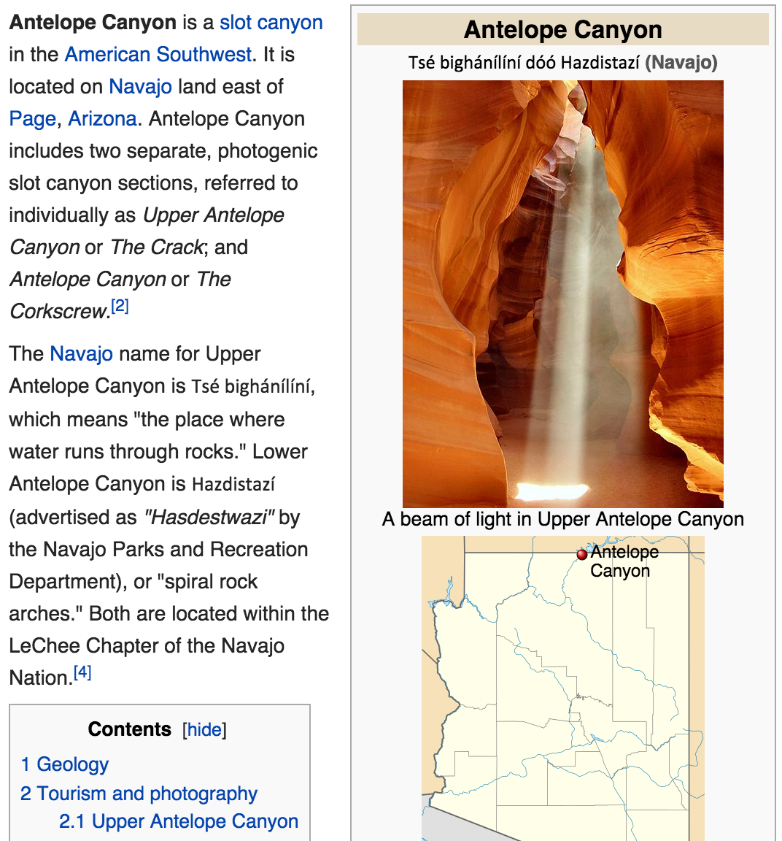
Map Example
Key = Title, Value = Article
Key:
Key:
“Mantis Shrimp”
“Antelope Canyon”
Value:
Value:

Slide 48
Map Example
Key = Title, Value = Article
Key:
Key:
“Mantis Shrimp”
“Antelope Canyon”
Value:
Value:
“<p><b>Mantis shrimp</b> or <b>stomatopods</b> are marine <a href="/wiki/Crustacean" title="Crustacean">crustaceans</a>, the members of the <a href="/wiki/Order_(biology)" title="Order (biology)">order</a> <b>Stomatopoda</b>. though a few species reach up to 38&#160;...”

Slide 49
Creating a Map
Requires 2 type parameters:
one for keys, one for values.
// maps from string keys to integer values
Map<string, int> votes;

Slide 50
Map Members
m.clear(); | removes all key/value pairs from the map
m.containsKey(key) | returns true if the map contains a mapping for the given key
m[key] or m.get(key) | returns the value mapped to the given key; if key not found, adds it with a default value (e.g. 0, "")
m.isEmpty() | returns true if the map contains no k/v pairs (size 0)
m.keys() | returns a Vector copy of all keys in the map
m[key] = value; or m.put(key, value); | adds a mapping from the given key to the given value; if the key already exists, replaces its value with the given one
m.remove(key); | removes any existing mapping for the given key
m.size() | returns the number of key/value pairs in the map
m.toString() | returns a string such as "{a:90, d:60, c:70}"
m.values() | returns a Vector copy of all values in the map

Slide 51
Map Example
Map<string, string> wiki;
// adds name / text pair to dataset
wiki.put(“Stanford Band”, articleHTML);
// returns corresponding articleHTML
wiki.get(“Mantis Shrimp”);
// removes the article
remove(“Trump”);

Slide 52
Types of Maps
Map
HashMap
Iterate over elements in sorted order
Element order is jumbled
Really Fast
Really, Ridiculously Fast
Implemented using a binary search tree
Implemented using a hash table

Slide 53
Tallies
count digits: 22092310907
index | 0 | 1 | 2 | 3 | 4 | 5 | 6 | 7 | 8 | 9
value | 3 | 1 | 3 | 0 | 0 | 0 | 0 | 1 | 0 | 2

Slide 54
Tallies
// (R)omney, (O)bama, (I)ndependent
count votes:
"ROOOOOORRRRROOOOOORORRIRORRIRORIO"
key | "R" | "O" | "I"
value | 14 | 16 | 3
16
"R"
"O"
3
"I"
14
keys
values

Slide 55
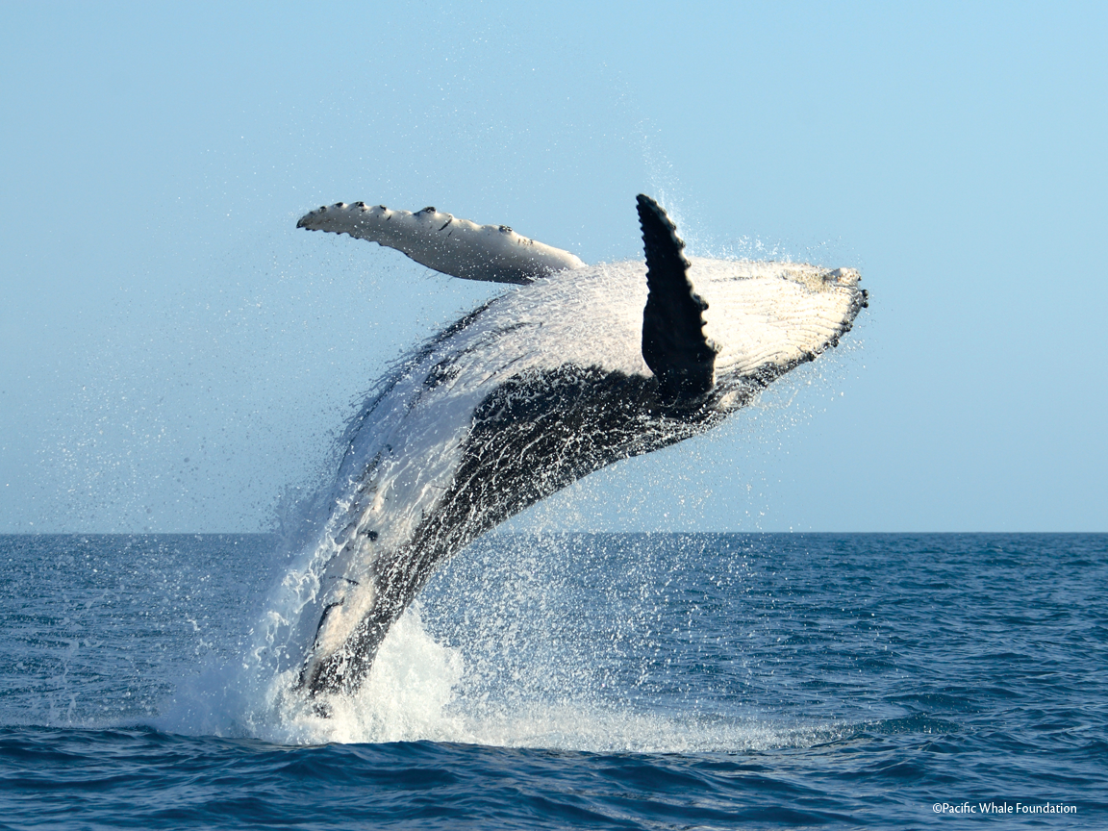
Problem #2: Tally Words

Slide 56
Looping Over a Map
Map<string, double> gpa = load();
for (string name : gpa) {
cout << name << "'s GPA is ";
cout << gpa[name] << endl;
}
*The order is unpredictable in a HashMap

Slide 57
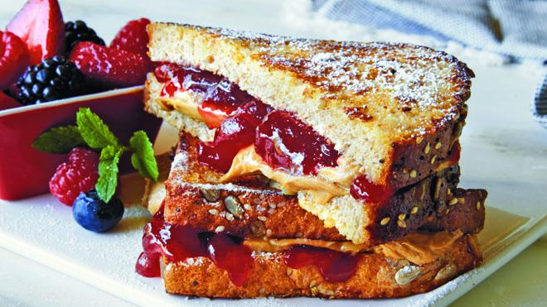
Sets, good
Maps, good
Sets + Maps, good

Slide 58
Malaria?
Wednesday
Bananagrams
Maps
Sets

Slide 59
Malaria?
Wednesday
Bananagrams
Maps
Sets

Slide 60
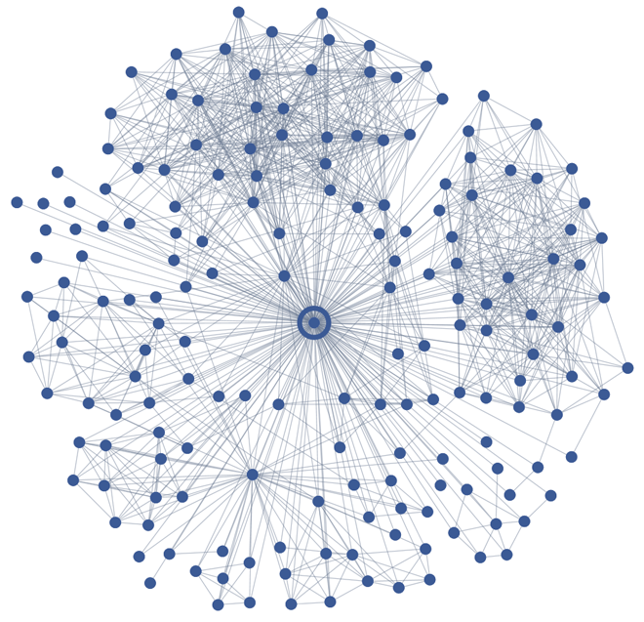

Compound Exampld
Example: how would you store people's Facebook friends?
i.e., I need to quickly look up the names of all of Jimmy's buddies, or test whether a given person is a friend of Jimmy's or not.
Map<string, Set<string> > pals;
pals["Jim"] += "Kate";
pals["Jim"] += "Bill";
pals["Mar"] += "Stuart";
pals["Jim"] += "Cindy";
pals["Hal"] += "Mar";
pals["Mar"] += "Helene";
cout << pals << endl;
// {Hal:{Mar},
Jim:{Bill, Cindy, Kate},
Mar:{Helene, Stuart}}

Slide 61
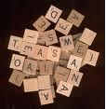
Anagram Exercise
Write a program to find all anagrams of a word the user types.
Type a word [Enter to quit]: scared
Anagrams of scared:
cadres
cedars
sacred
scared
What is the appropriate collection to use to solve this problem?
Hint: Use a compound collection...

Slide 62
Aka how to beat your friends at word games

Slide 63
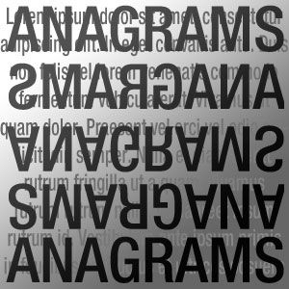
Problem #3: Anagrams

Slide 64
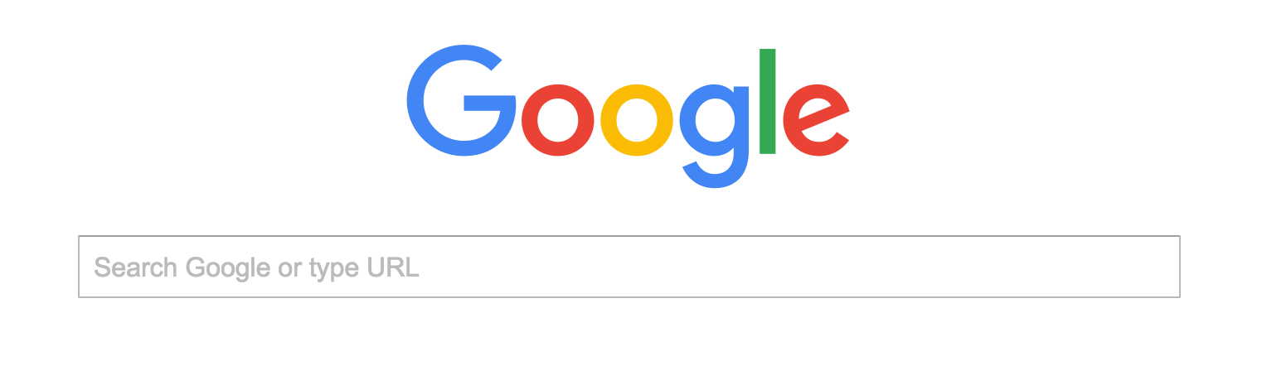
Me This Morning
I’m really into this anagram solution. It feels like it can be used for so much more…
soon
Bananagrams artificial intelligence

Slide 65
Me This Morning
Bananagrams vs computer
Bananagrams online
number of legal moves in bananagrams

Slide 66
We may be the first…

Slide 67
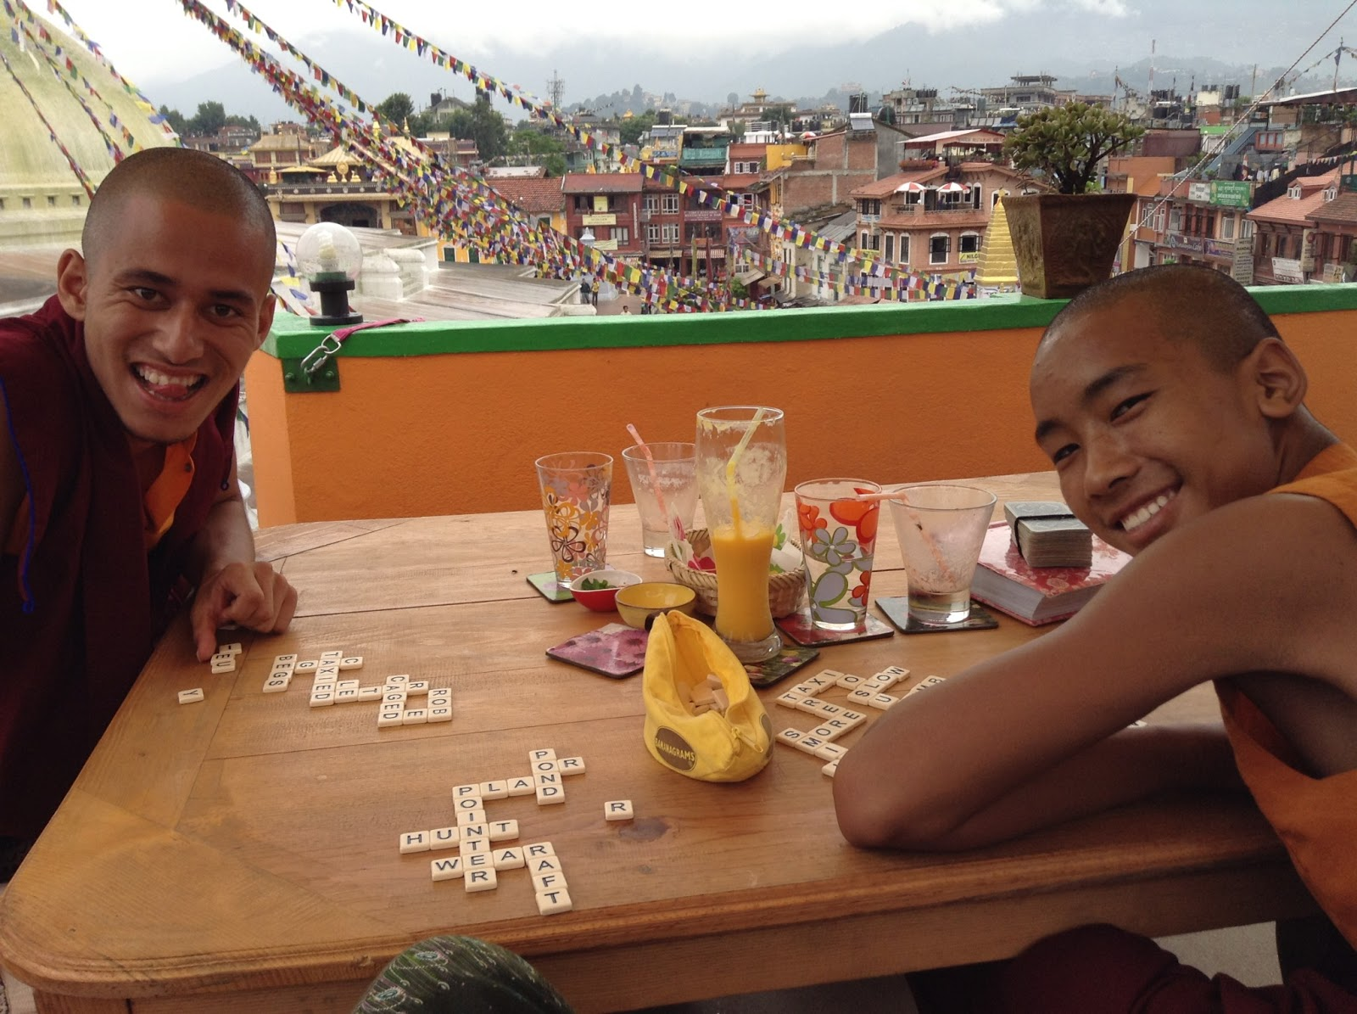
Bananagrams
Bananagrams
http://mysummeratamonastery.blogspot.com/2013/07/cel-rotis-stolen-money-and-bananagrams.html

Slide 68
Bananagrams
L E F N W D R
E L C A I E I
Y N S O S S T

Slide 69
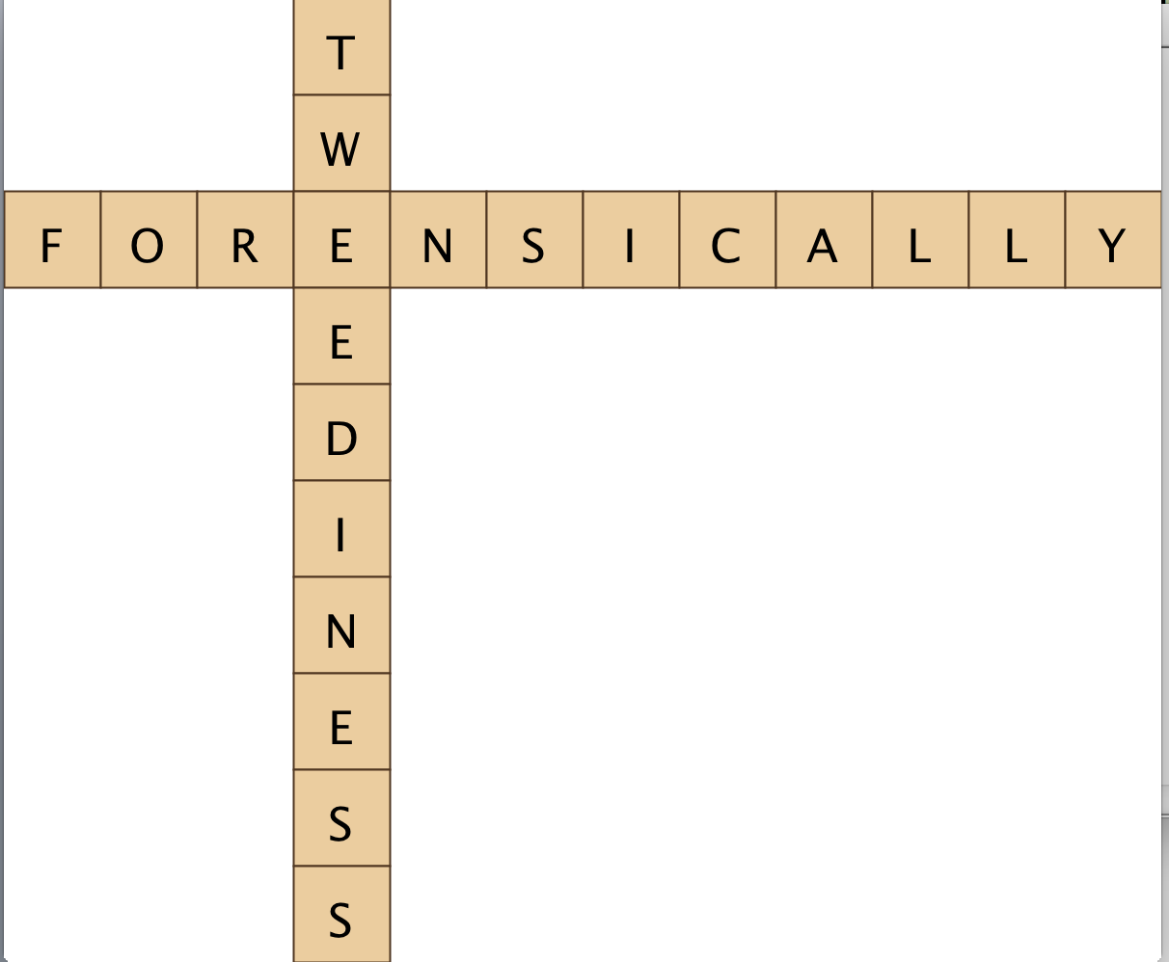
Bananagrams
Tiles:
L E F N W D R
E L C A I E I
Y N S O S S T

Slide 70
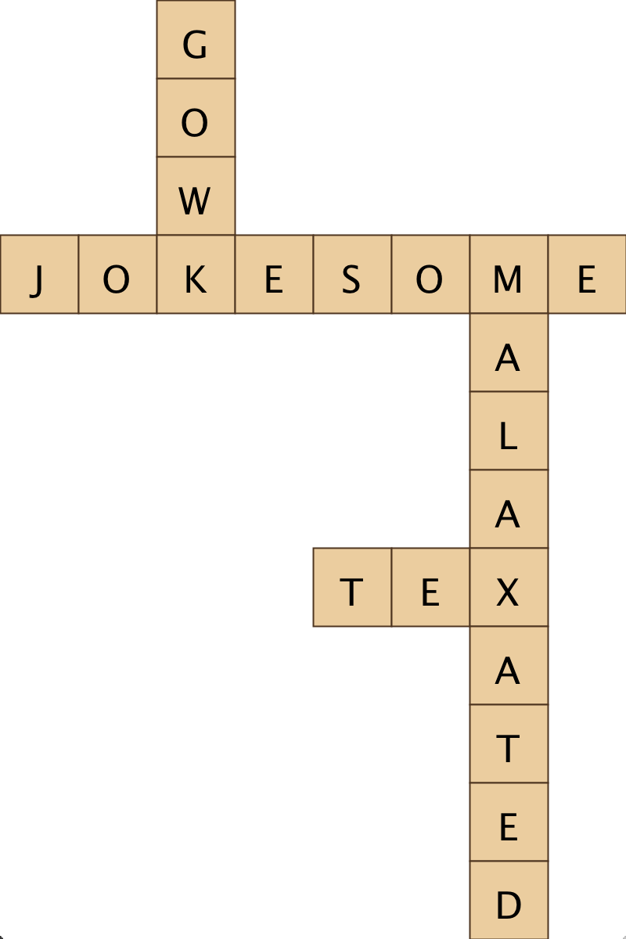
Bananagrams
Tiles: DTGEMAOTOWKJEAAESELXO

Slide 71
That’s all folks.

Slide 72
Malaria?
Wednesday
Bananagrams
Maps
Sets

Slide 73
Today’s Goals
Learn how to use Sets
Learn how to use Maps
See a previously never seen before computer program

Slide 74
Interesting Puzzle
Counterfeiter
?
User
You (Distributor)

